Slide 1
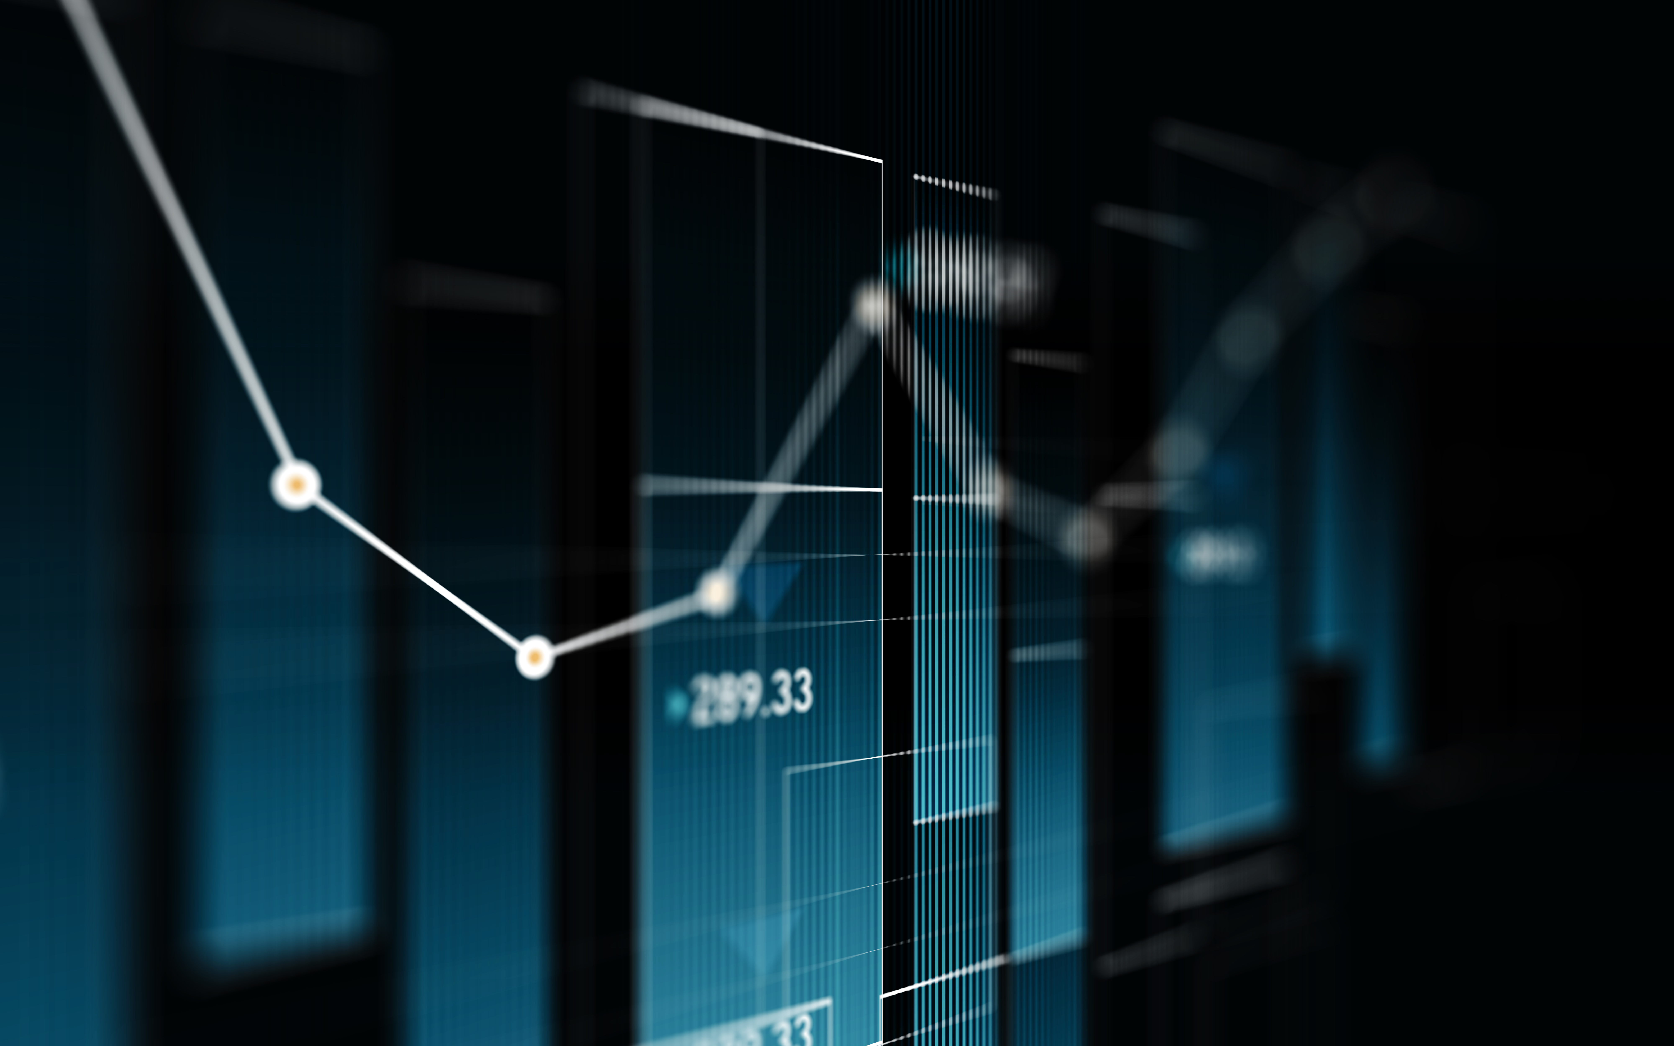
Physics Final
Jon Braunsma Jr.

Slide 2
Introduction
Time to get Physic-al
Real-world applications
Understanding through experiments

Slide 3
Software Requirements for course
Arduino IDE
Excel

Slide 4
Ultrasonic Sensor
To observe the precision of the ultrasonic sensor
Hands on experiment with sound waves

Slide 5
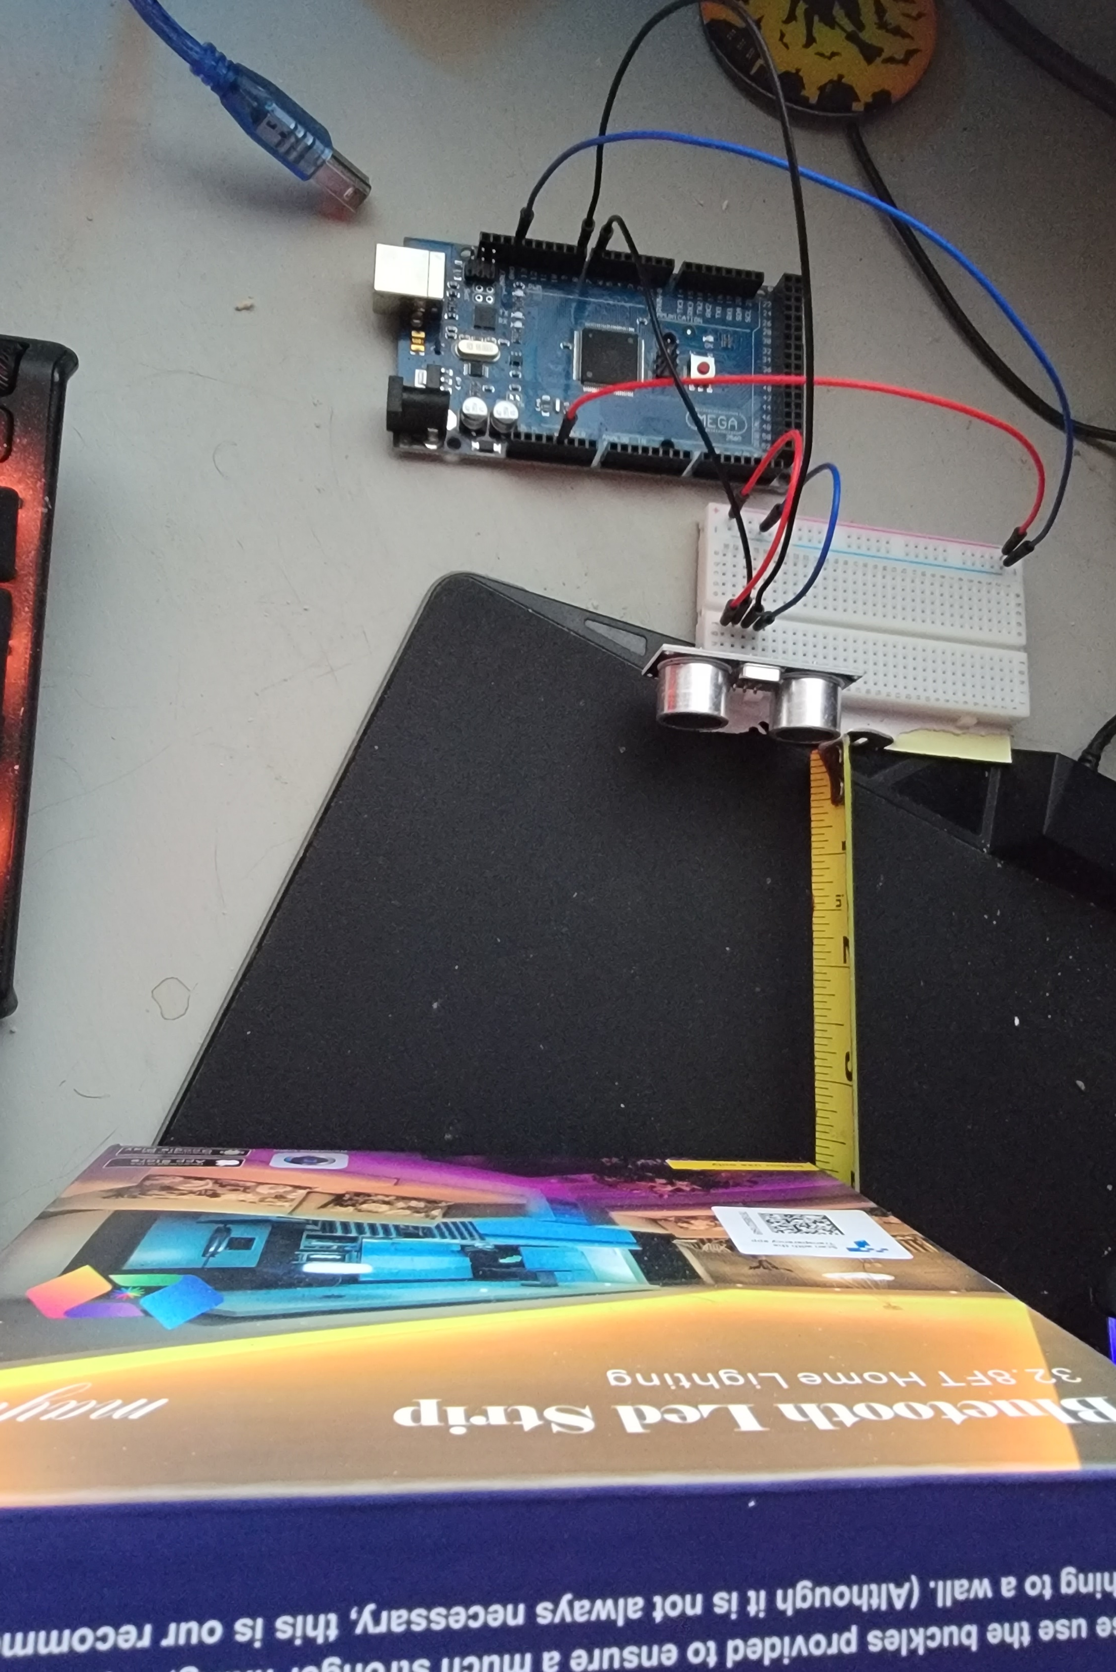
Required Materials
Mega 2560 Board
Ultrasonic Sensor HC-SR04
Male to Male Wires
Breadboard
Ruler / Tape Measure
Object to act as obstacle

Slide 6
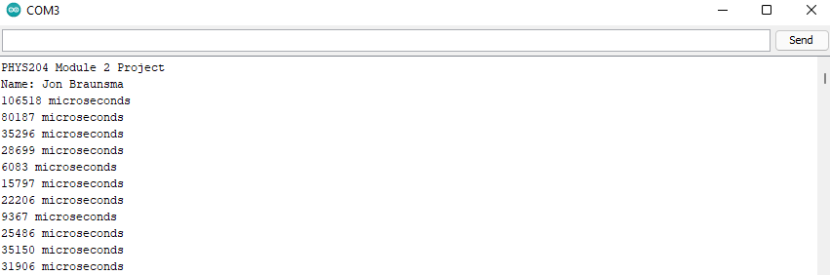
IoT Output
The output shows the round trip for the sound to bounce off the obstacle and come back.
The time + speed of sound can be used to calculate distance, or in law enforcement – your speed!

Slide 7
Data Analysis
Trial | Ruler Distance (cm) | Total Roundtrip Distance (m) | Time from Serial Monitor (microseconds) | Roundtrip time (s) | Velocity = distance/time (m/s)
1 | 5.08 | 0.1016 | 302 | 0.000302 | 336.42
2 | 7.62 | 0.1524 | 475 | 0.000475 | 320.84
3 | 12.7 | 0.254 | 745 | 0.000745 | 340.94
4 | 15.24 | 0.3048 | 910 | 0.000910 | 334.94
5 | 17.78 | 0.3556 | 1042 | 0.001042 | 341.26

Slide 8
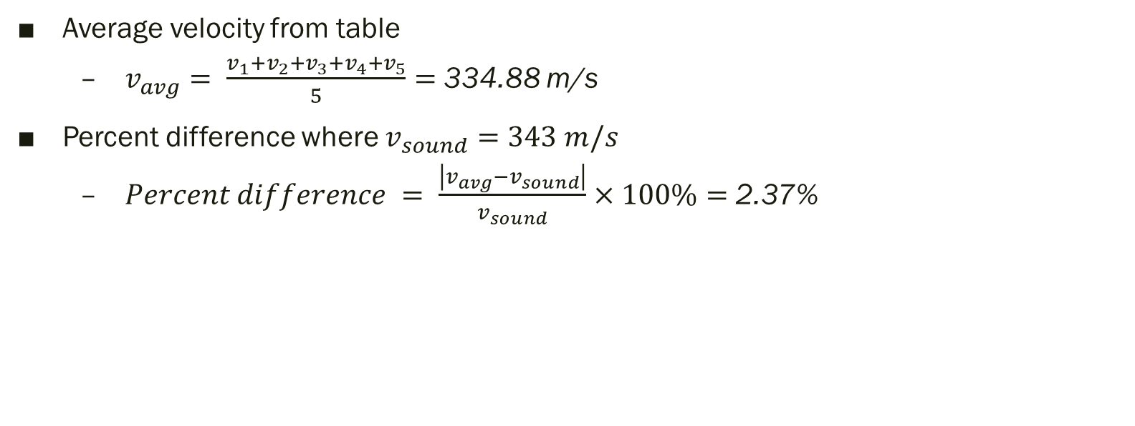
Data Analysis Pt. 2
Average velocity from table
$v_{avg}= \frac{v_{1}+v_{2}+v_{3}+v_{4}+v_{5}}{5}=$ 334.88 m/s
Percent difference where $v_{sound}=343 m/s$
$Percent difference = \frac{\left|v_{avg}−v_{sound}\right|}{v_{sound}}×100\%=$ 2.37%

Slide 9
Ultrasonic Conclusions
It is nearly impossible to have the exact distance measured by hand. Additionally, the sensor is not of the utmost quality thus not as accurate.
In regard to temperature, humidity, and atmospheric pressure – warmer temperatures will increase the speed of sound. Meanwhile, lower temperatures will decrease it. Humidity will require factoring how water can distort/bend the speed of sound, thus the greater the humidity the less accurate results will be.

Slide 10
Ultrasonic Gravity
To observe the effects of gravity
Experiment with ultrasonic sensor

Slide 11
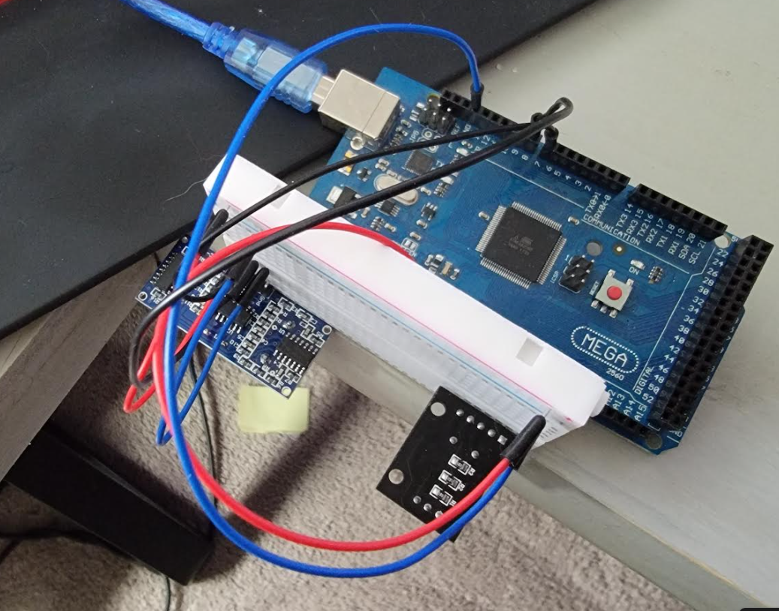
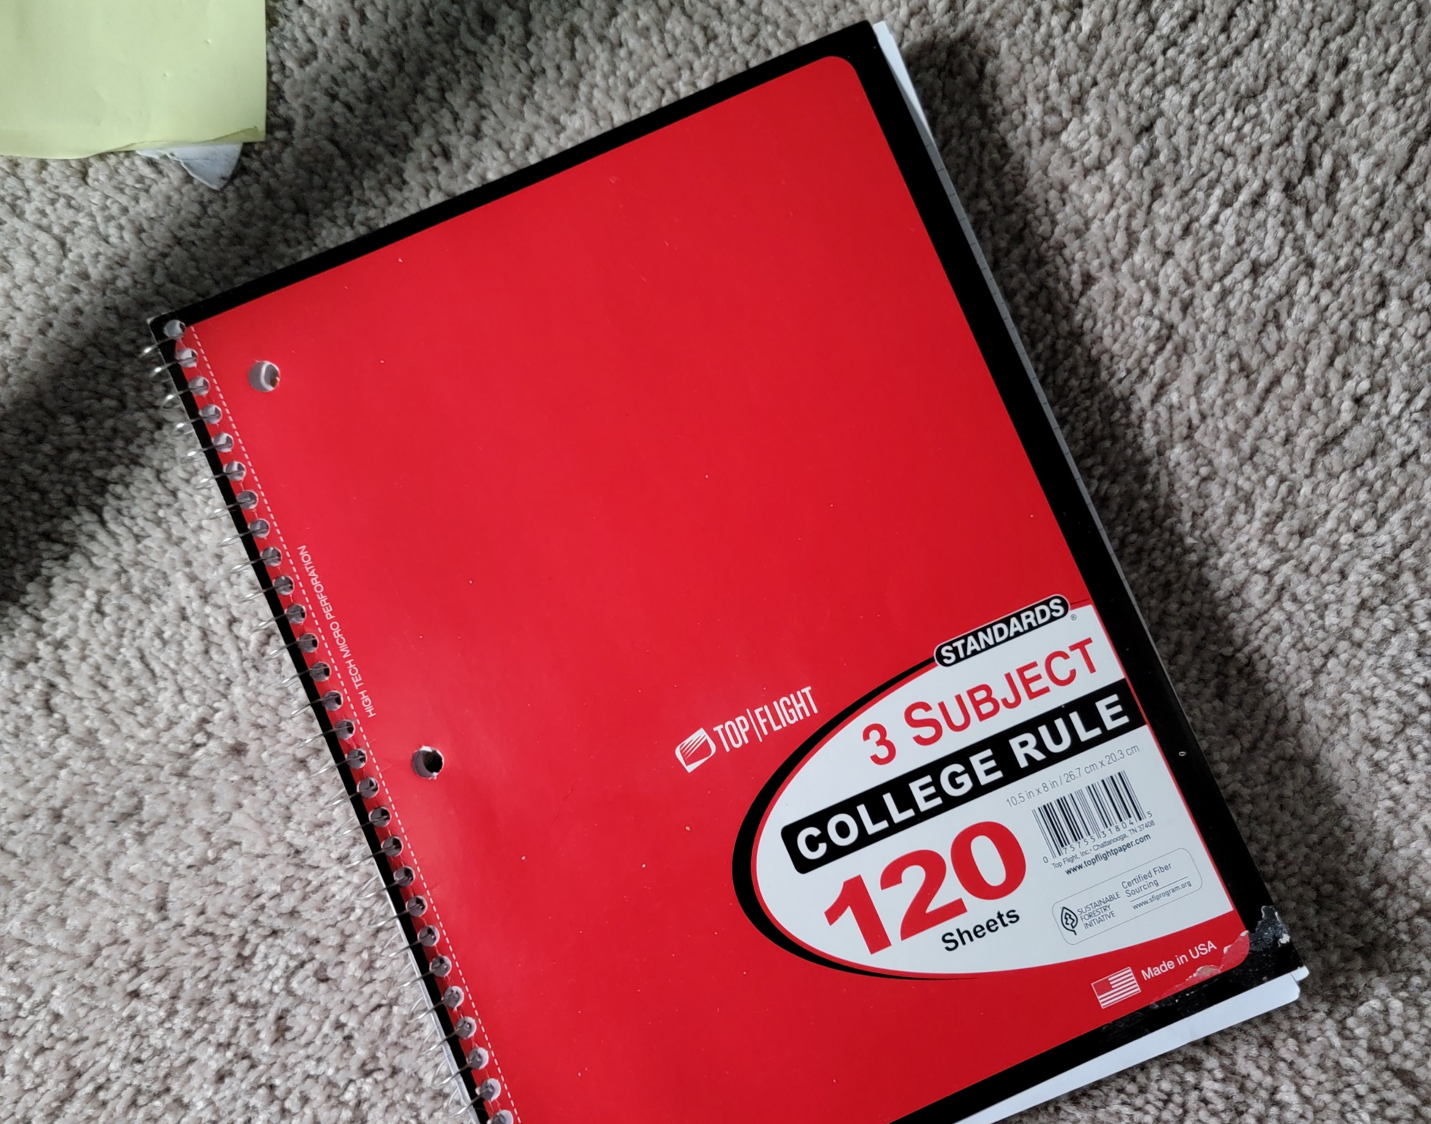
Required Materials
Mega 2560 Board
Ultrasonic sensor HC-SR04
Male to Male Wires
Breadboard
Object to undergo freefall motion

Slide 12
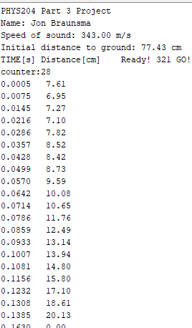
IoT Output
The device outputs a countdown timer. This is when the experiment is prepped (object is placed under the sensor).
When countdown says “Go!” the object is to be dropped
Device measures time and distance which gets outputted to the console window.

Slide 13
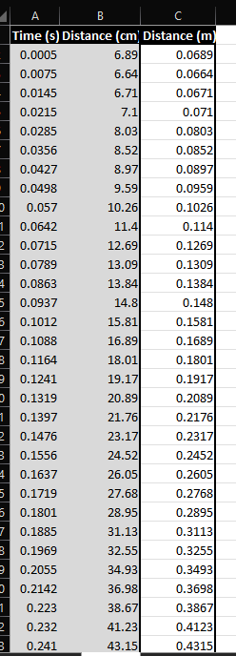
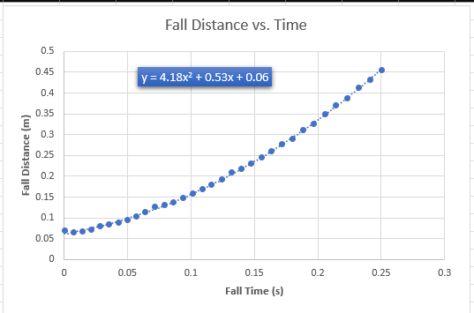
Excel Data
Simply copied the output from the IoT device and pasted it into an excel spreadsheet

Slide 14
Data Collection
Trial | x² coefficient value from curve fitting | Acceleration (m/s²) = 2* (x² coefficient)
1 | 4.18 | 8.36
2 | 4.48 | 8.96
3 | 5.18 | 10.36
4 | 4.45 | 8.9
5 | 4.37 | 8.74

Slide 15
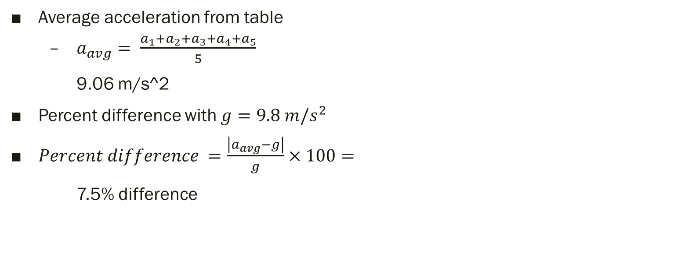
Data Analysis
Average acceleration from table
$a_{avg}= \frac{a_{1}+a_{2}+a_{3}+a_{4}+a_{5}}{5}$
9.06 m/s^2
Percent difference with $g=9.8 m/s^{2}$
$Percent difference =\frac{\left|a_{avg}−g\right|}{g}×100=$
7.5% difference

Slide 16
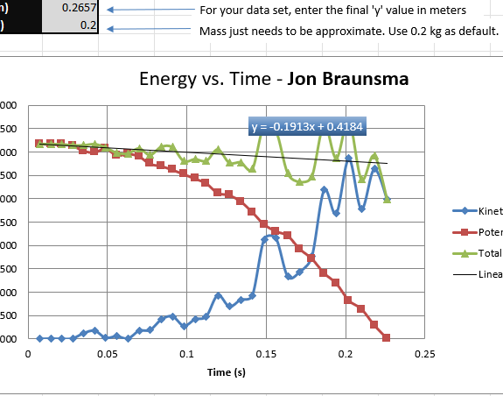
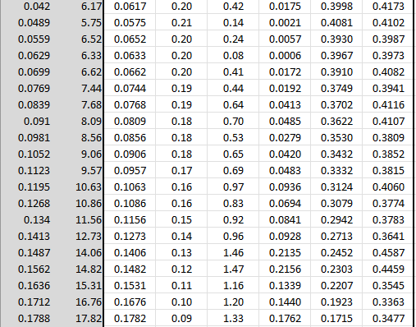
Freefall Additional analysis

Slide 17
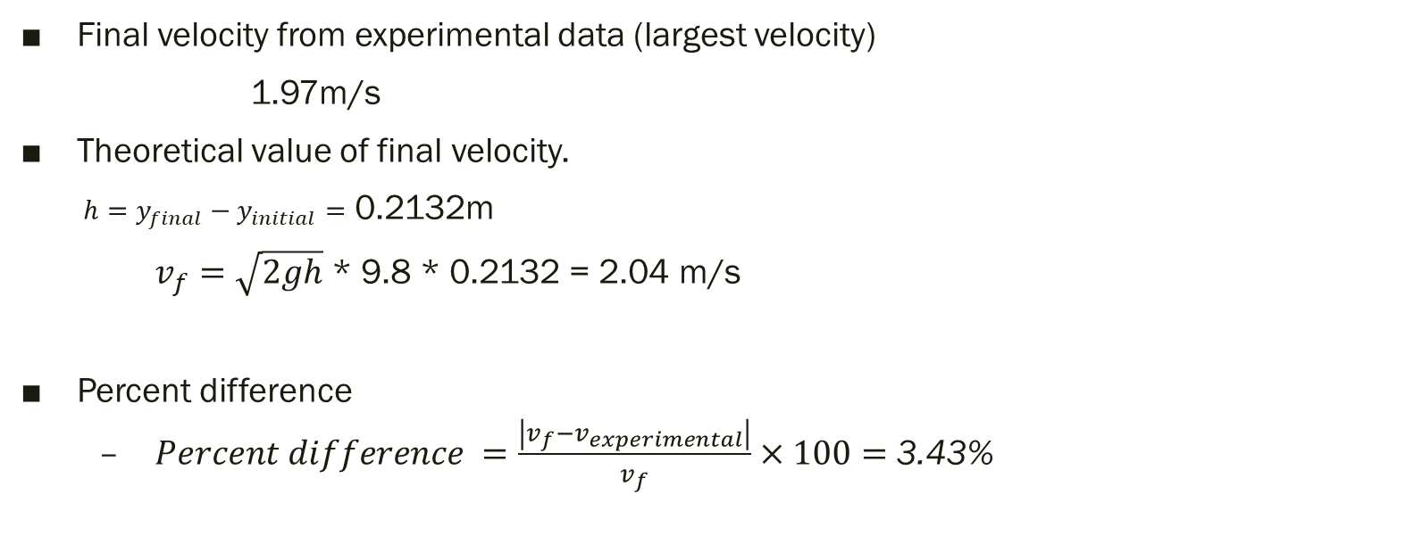
Data Validation
Final velocity from experimental data (largest velocity)
1.97m/s
Theoretical value of final velocity.
$h=y_{final}−y_{initial}=$ 0.2132m
$v_{f}=\sqrt{2gh}$ * 9.8 * 0.2132 = 2.04 m/s
Percent difference
$Percent difference =\frac{\left|v_{f}−v_{experimental}\right|}{v_{f}}×100=$ 3.43%

Slide 18
Gravity Conclusions
The sensor, is again not perfect. The angle of the sensor is not a perfect 90 degree facing downward.
Free fall object can be affected by air resistance
The variation from trial to trial is due to a few things
Manually holding object – thus dropping is not precise
Sensor had external interference, or inaccuracies because at one point it said 128cm to ground, another it said 78cm while being in the same spot!
Kinetic energy is lowest when potential is highest. Kinetic is highest when potential is lowest. The intersection of the two, that’s when energy is the “lowest”

Slide 19
Hall Effect Project
Observe the hall effect
Hands on experiment for testing magnetism

Slide 20
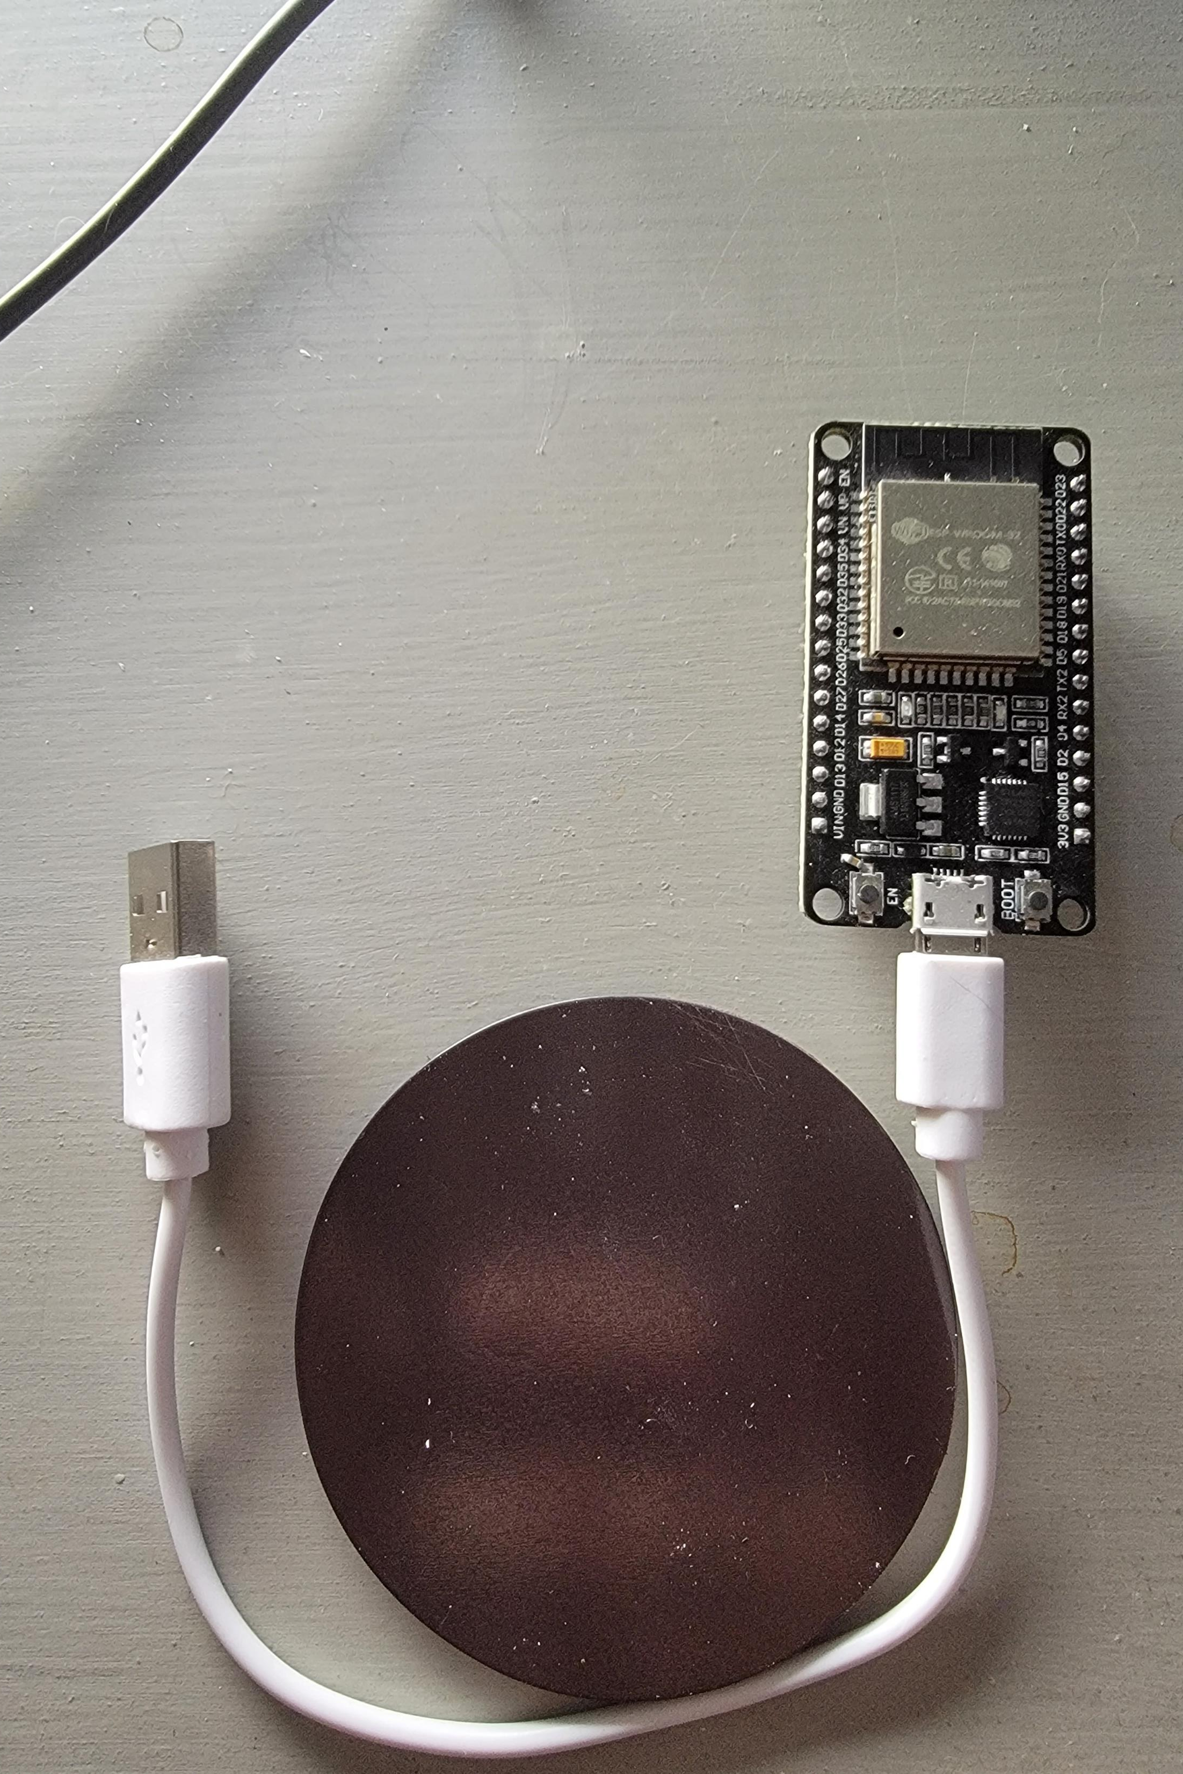
Required Materials
1 ESP32 Board
1 Micro-USB
1 Magnet (such as a refrigerator magnet)

Slide 21
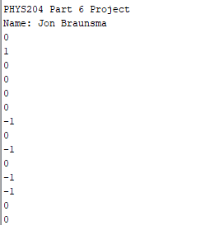
IoT Output
Swapped for a longer micro-usb cable and was unable to get a stabilized reading
For this experiment anything between -1 and 1 will be considered “base”

Slide 22
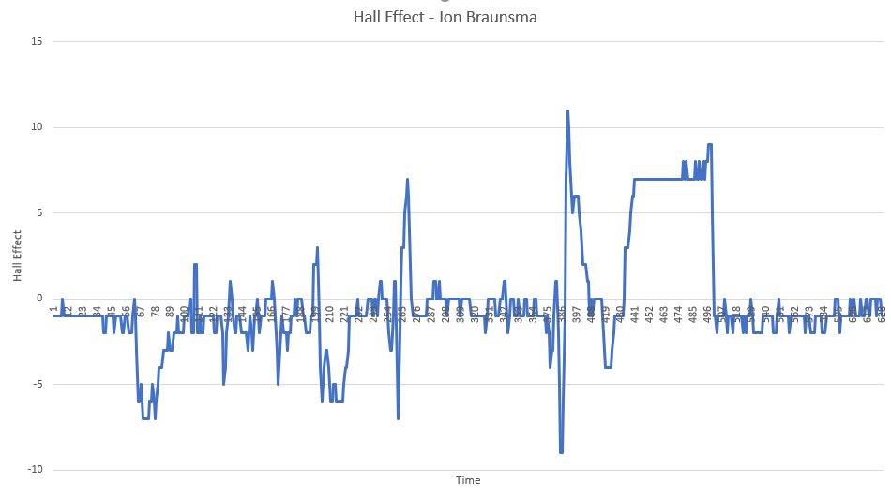
Data Analysis
The stair-case like part of the graphs was me experimenting with distance
I also noticed that due to the circular magnet I could flip polarity, as noticed by the spikes from + to -, or – to +.

Slide 23
Hall Effect Conclusions
This experiment is not perfect, and the sensor is not of high precision. Having multiple electronic devices in the vicinity may have impacted the baseline.
Can utilize the hall effect for home security! Two sensor can be added onto entry points, when separated the reading should be 0 thus the window or door is ajar.
Hall effect works by an external magnetic source pushing charged particles to opposite sides.

Slide 24
Challenges
Had to troubleshoot a driver issue with ESP32, ended up being a cable issue. Swapped micro-usb which resolved problem
Short cables equated to limited space for experiments
Precision, hard to achieve precision with eyeballing measurements and using nonscientific grade hardware.

Slide 25
Career Skills
Game Development
Majority of games require some level of physics. From velocity, to AI leading their shots to hit a moving target.
Critical thinking
Ability to take a problem and logically walk through it step by step to achieve a solution

